Slide 1
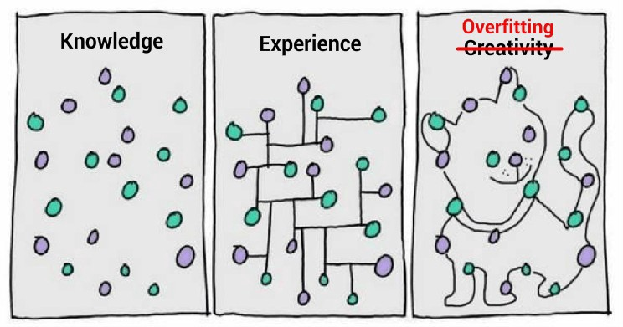
Regularization for Reducing Overfitting
PhD. Msc. David C. Baldears S.
PhD.(s) Msc. Diego López Bernal
TC3007C
https://cnvrg.io/data-science-platform/dataset-management/

Slide 2
Penalizing Model Complexity
We want to avoid model complexity where possible.
We can introduce this idea into the optimization we do at training time.
Structural Risk Minimization:
Normally minimize: Loss(Data|Model)
Penalizing complexity, minimize: Loss(Data|Model) + complexity(Model)
aim for low training error
aim for low training error
...but balance against complexity

Slide 3
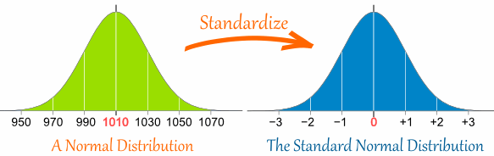
Regularization
How to define complexity(model)?
One possible "prior belief" is that weights should be normally distributed around 0
Diverging from this should incur a cost
Can encode this idea via L₂ regularization
complexity(model) = sum of squares of the weights
a.k.a. square of the L₂ norm of the weight vector
Encourages small weights centered around zero

Slide 4

L₂ Regularization
aim for low training error
...but balance against complexity
λ controls how these are balanced
What’s a good λ?
Notes:
\text{Training Loss} + \lambda\sqrt{w_1^{2}+w_2^{2}+\cdots+w_n^{2}}

Slide 5
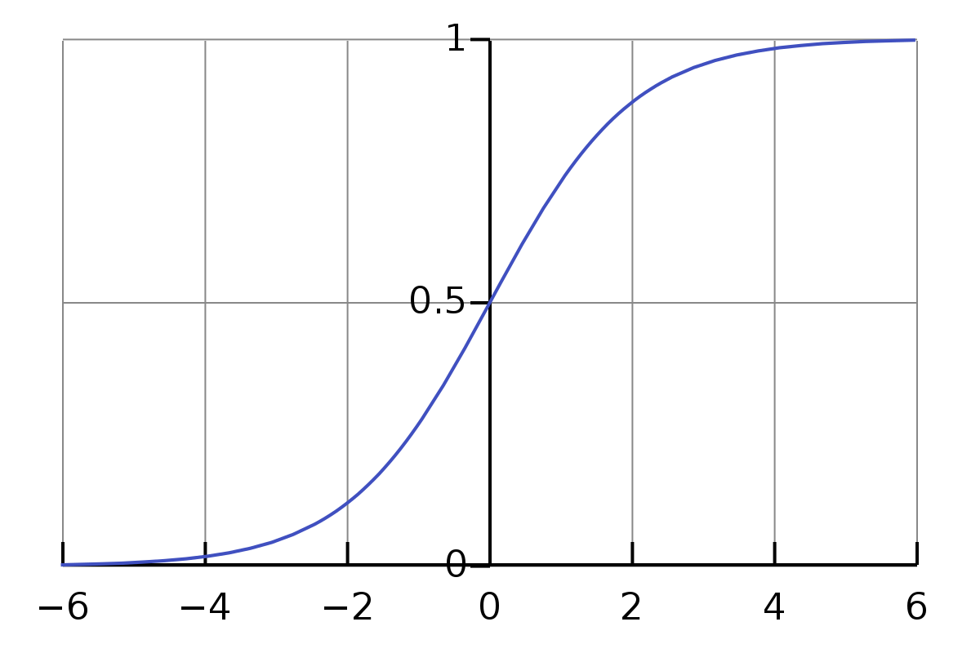

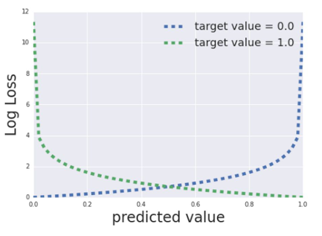

Remember Logistic Regression
Replacing ß with w The Loss
Notes:
\sigma(f(x)) = \frac{1}{1+e^{\left(-f(x)\right)}}
f(X) = w_0+w_1x_1 + w_2x_2 + \cdots + w_nx_n
\text{Log Loss}=-yln(\pi\strut_{\beta}) - (1-y)ln(1-\pi\strut_{\beta})

Slide 6



L₂ Regularization
Ridge regression adds the “squared magnitude” of the coefficient as the penalty term to the loss function.
And its gradient will remain the same plus the sum of the weights times λ
Notes:
L_2 = \lambda \sum\limits_{i=1}^{n} w_n^{2}

Slide 7
Logistic Regression and Regularization
Regularization is super important for logistic regression.
Remember the asymptotes
It’ll keep trying to drive loss to 0 in high dimensions
Two strategies are especially useful:
L₂ regularization -- penalizes huge weights.
Early stopping -- limiting training steps or learning rate.

Slide 8

L₁ Regularization
L1 regularization, also known as L1 norm or Lasso (in regression problems), combats overfitting by shrinking the parameters towards 0.
Lasso is an acronym for least absolute shrinkage and selection operator, and lasso regression adds the “absolute value of magnitude” of the coefficient as a penalty term to the loss function.
Notes:
L_1 = \lambda \sum\limits_{i=1}^{n} |w_n|

Slide 9
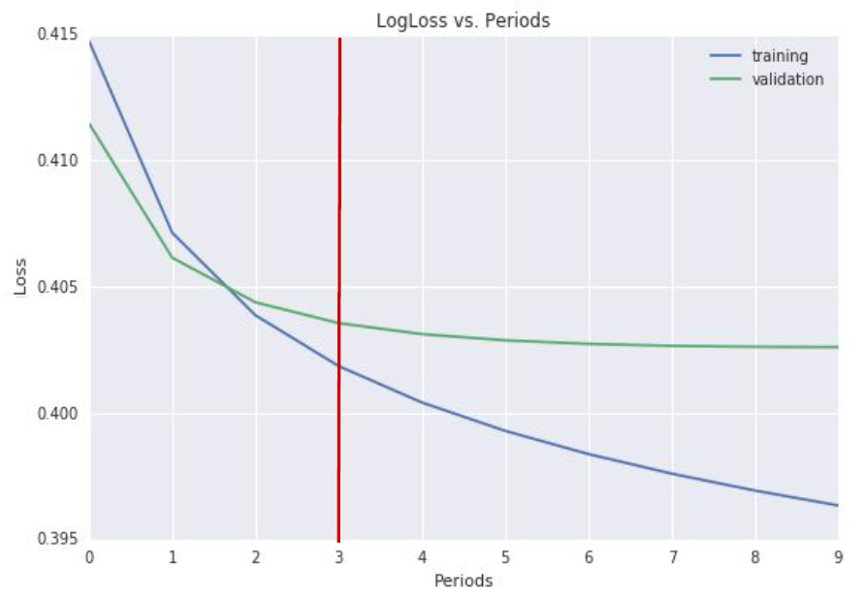
Other Ways to Prevent Overfitting
Early stopping:
Use learning curve to detect overfitting.
Stop training at somewhere around the red line.
Are there better approaches?

Slide 10
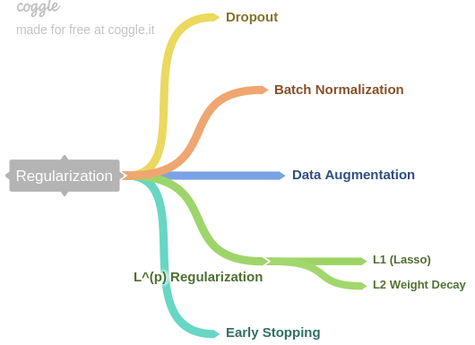
Other forms of Regularization

Slide 11
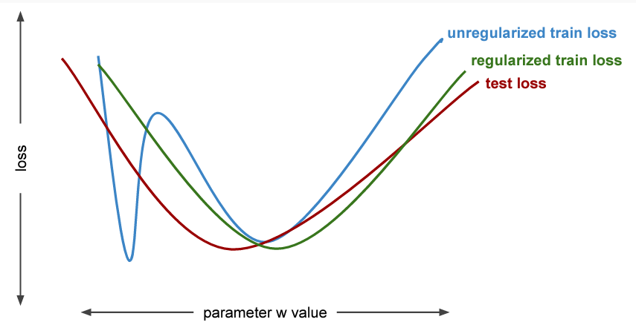
Regularized train loss (cartoon)

